Slide 1

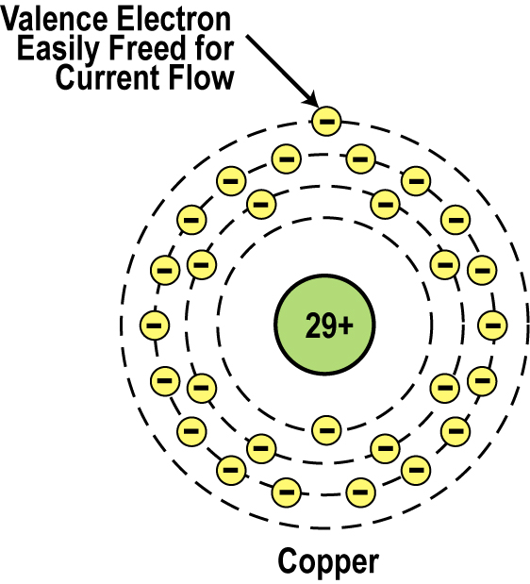
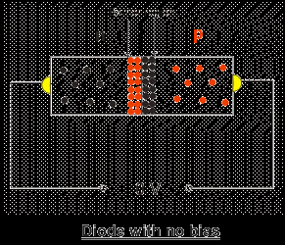
Introduction to Semiconductor Materials
_{Copper Atom}

Slide 2
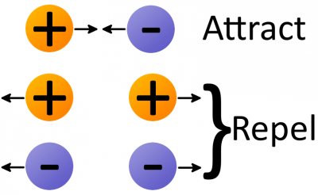
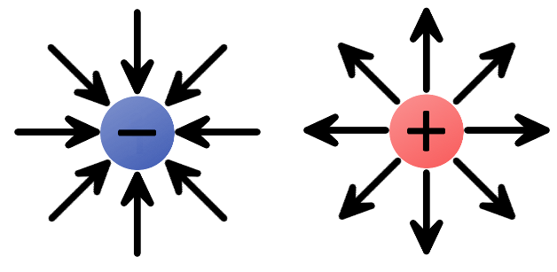
Electrostatic force
Electrostatic force (also called Coulomb’s law) is a force that operates between charges. It states that charges of the same type repel each other, while charges of opposite types are attracted together. Opposites attract, and likes repel.
A negative charge has an inward electric field because it attracts positive charges.
The positive charge has an outward electric field, pushing away like charges.

Slide 3
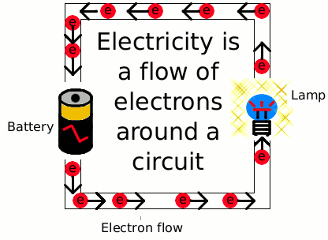
Electronic Materials
The goal of electronic materials is to generate and control the flow of an electrical current.
Electronic materials include:
Conductors: have low resistance which allows electrical current flow
Insulators: have high resistance which suppresses electrical current flow
Semiconductors: can allow or suppress electrical current flow

Slide 4
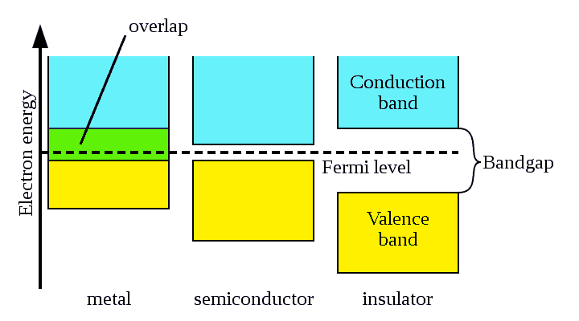
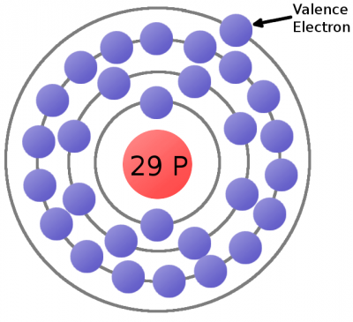
Conductors
This is a copper atom diagram: 29 protons in the nucleus, surrounded by bands of circling electrons. Electrons closer to the nucleus are hard to remove while the valence (outer ring) electron requires relatively little energy to be ejected from the atom.

Slide 5
Conductors
Good conductors have low resistance so electrons flow through them with ease. The atomic structure of good conductors usually includes only one electron in their outer shell. It is called a valence electron.
It is easily striped from the atom, producing current flow.
Electric field
Copper Atom

Slide 6
Electron Flow in a Simple Circuit
Now consider a copper wire: As free electron is floating in a space between atoms, it’s pulled by surrounding charges in that space. In this chaos the free electron eventually finds a new atom to latch on to; in doing so, the negative charge of that electron ejects another valence electron from the atom. Now a new electron is drifting through free space looking to do the same thing. This chain effect can continue on and on to create a flow of electrons called electric current.
Electric field

Slide 7
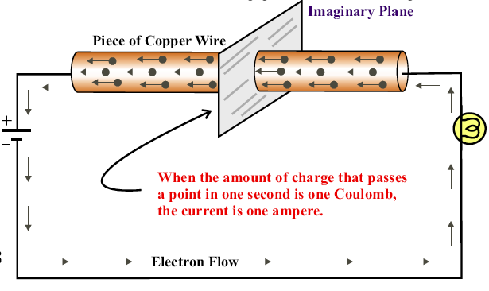
Electric Current

Slide 8
Insulators
Insulators have a high resistance so current does not flow in them. The atoms are tightly bound to one another so electrons are difficult to strip away for current flow.
Insulators have 8 valence electrons.
Good insulators include: Glass, ceramic, plastics, & wood.

Slide 9
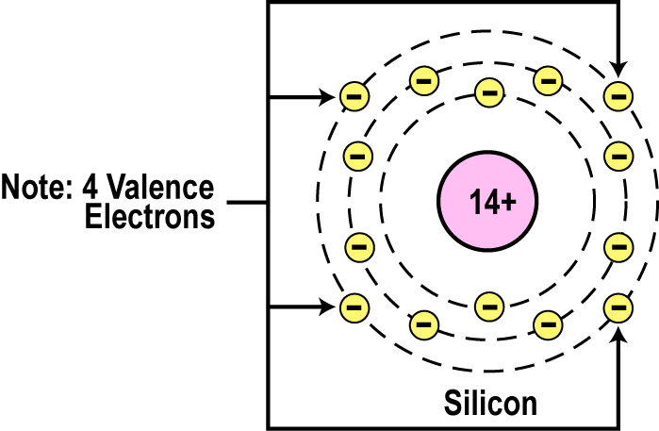
Semiconductors
Semiconductors are materials that essentially can be conditioned to act as good conductors, or good insulators, or any thing in between.
The main characteristic of a semiconductor element is that it has 4 valence electrons in its outer or valence orbit.
Common elements such as carbon, silicon, and germanium are semiconductors. Silicon is the best and most widely used semiconductor.

Slide 10
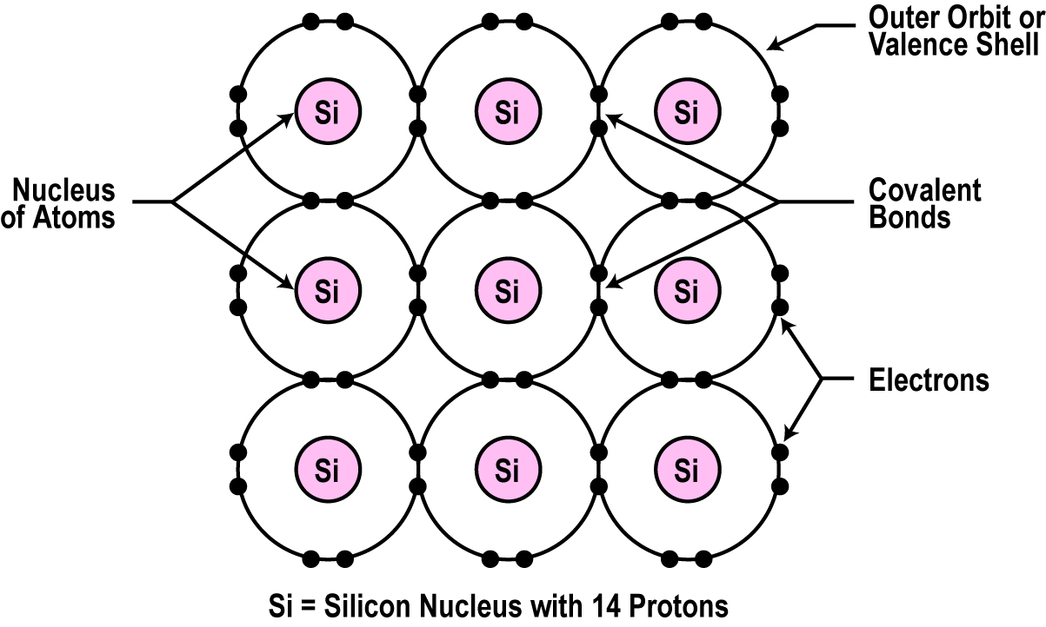
Crystal Lattice Structure
The unique capability of semiconductor atoms is their ability to link together to form a physical structure called a crystal lattice.
The atoms link together with one another sharing their outer electrons.
These links are called covalent bonds.
2D Crystal Lattice Structure

Slide 11
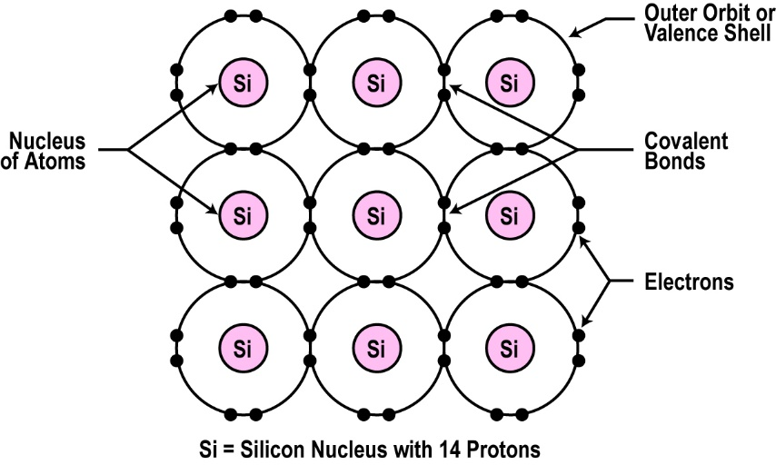
Semiconductors can be Insulators
If the material is pure semiconductor material like silicon, the crystal lattice structure forms an excellent insulator since all the atoms are bound to one another and are not free for current flow.
Since the outer valence electrons of each atom are tightly bound together with one another, the electrons are difficult to dislodge for current flow.
Silicon in this form is a great insulator.

Slide 12
Doping
Doping: To make the semiconductor conduct electricity, other atoms called impurities must be added. The process of adding impurities to the intrinsic material giving the material a Positive or Negative characteristic.
SI
N
P
SI
SI
SI
SI
N
SI
SI
SI
SI
SI
SI
SI
SI
SI
P
SI
SI
SI
SI
SI
SI
SI
SI
SI
SI
SI
SI
SI
SI
Covalent Bonding;
Undoped Material Shares its 4 electrons w/other atoms and forms a pure crystal.
Pentavalent Doping;
Donor Material Impurities that have an excess of electrons. N type Material, called Electrons. - charged
Trivalent Doping;
Acceptor Material Impurities that have missing electron, called Holes or P type Material. + charged.

Slide 13
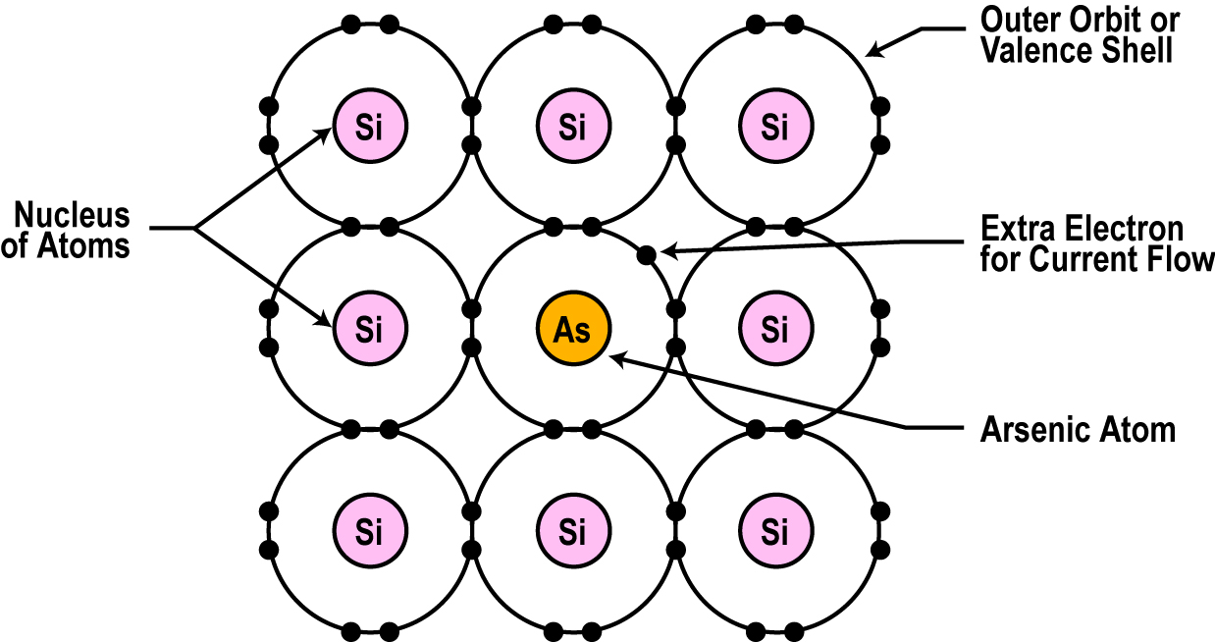
Semiconductors can be Conductors
An impurity, or element like arsenic, has 5 valence electrons.
Adding arsenic (doping) will allow four of the arsenic valence electrons to bond with the neighboring silicon atoms.
The one electron left over for each arsenic atom becomes available to conduct current flow.

Slide 14
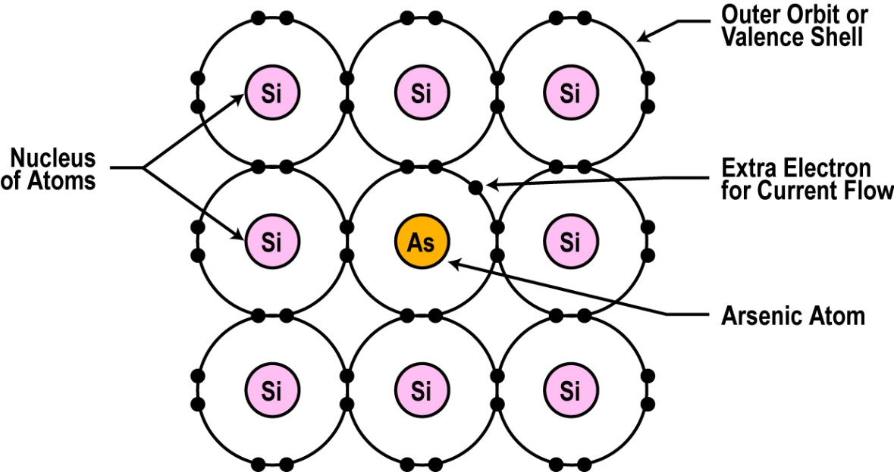
Resistance Effects of Doping
If you use lots of arsenic atoms for doping, there will be lots of extra electrons so the resistance of the material will be low and current will flow freely.
If you use only a few arsenic atoms, there will be fewer free electrons so the resistance will be high and less current will flow.
By controlling the doping amount, virtually any resistance can be achieved.

Slide 15
n-type material
Donor Material has an excess electron in the covalent bond.
Majority Carriers are Electrons.
N
I
N
N
N
SI
SI
SI
SI
SI
SI
SI
SI
SI
SI
SI
SI
SI
N
N
SI
SI
SI
SI
SI
V
The DC voltage source has a positive terminal that attracts (pulls) the free electrons in the semiconductor and pulls them away from their atoms leaving the atoms charged positively.
Electrons from the negative terminal of the supply enter the semiconductor material and are attracted by the positive charge of the atoms missing one of their electrons.
Electrons flows from negative terminal to the positive terminal.

Slide 16
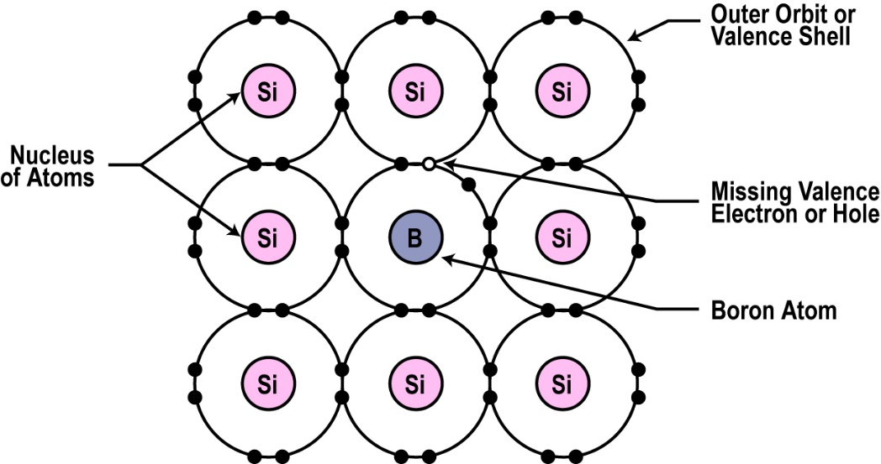
Another Way to Dope
You can also dope a semiconductor material with an atom such as boron that has only 3 valence electrons.
The 3 electrons in the outer orbit do form covalent bonds with its neighboring semiconductor atoms as before. But one electron is missing from the bond. This place where a fourth electron should be is referred to as a hole.
The hole assumes a positive charge so it can attract electrons from some other source.
Holes become a type of current carrier like the electron to support current flow.

Slide 17
p-type material
Acceptor Material has a missing electron in the covalent bond w/Silicon,
Majority Carriers are Holes.
P
Electrons from the negative supply terminal are attracted to the positive holes and fill them. The positive terminal of the supply pulls the electrons from the holes leaving the holes to attract more electrons. Current (electrons) flows from the negative terminal to the positive terminal. Inside the semiconductor current flow is actually by the movement of the holes from positive to negative.
I
SI
SI
SI
SI
SI
SI
P
P
SI
SI
SI
SI
SI
SI
P
P
SI
SI
SI
SI
SI
SI
I
P
P
P
V

